Slide 1

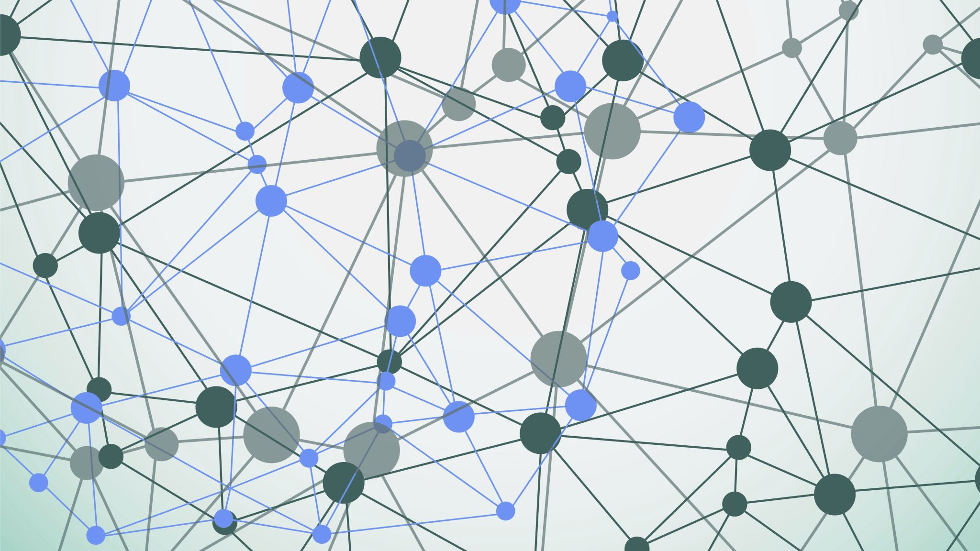
YouTube
Social Network

Slide 2

Group Names
أحمد مصطفى عبدالحميد محمود (section1)
مصطفى سمير مصطفى (section3)
محمود عماد الدين عبدالسلام (section3)
مصطفى عطية احمد (section3)
محمد صفوت خضر (section3)

Slide 3
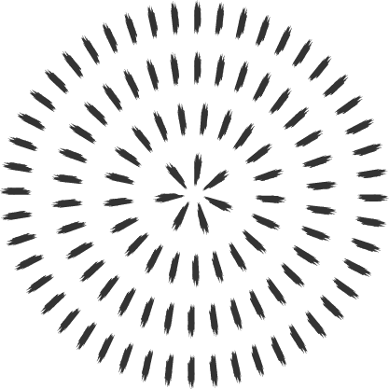

Dataset
Youtube social network | Kaggle
About Dataset
YouTube social network and ground-truth communities
Dataset information
YouTube is a video-sharing web site that includes a social network. In the YouTube social network, users form friendship each other and users can create groups which other users can join. We consider such user-defined groups as ground-truth communities. This data is provided by Alan Mislove et al.
We regard each connected component in a group as a separate ground-truth community. We remove the ground-truth communities which have less than 3 nodes. We also provide the top 5,000 communities with highest quality which are described in our paper. As for the network, we provide the largest connected component.

Slide 4
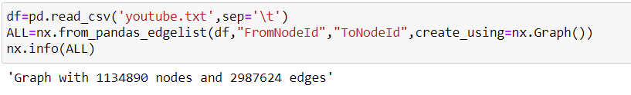
Dataset Info.

Slide 5
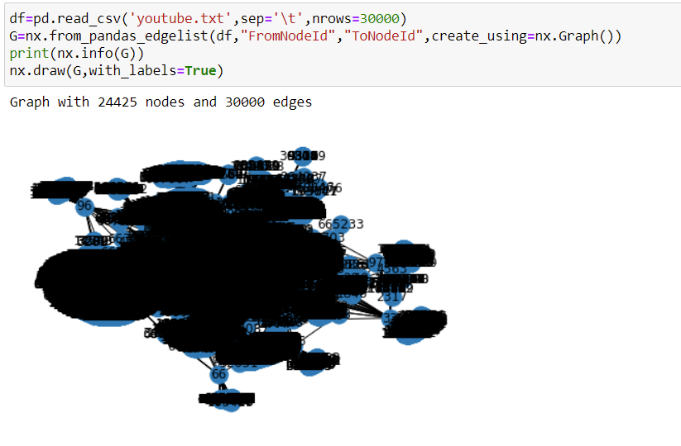
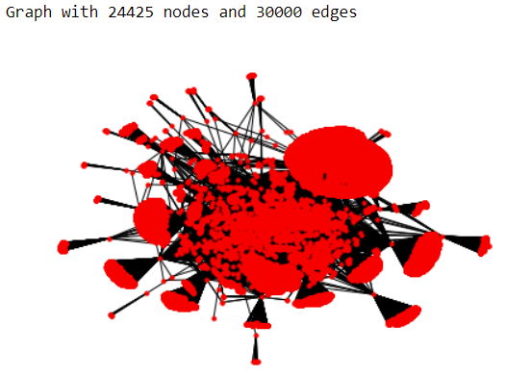
Sample Graph

Slide 6
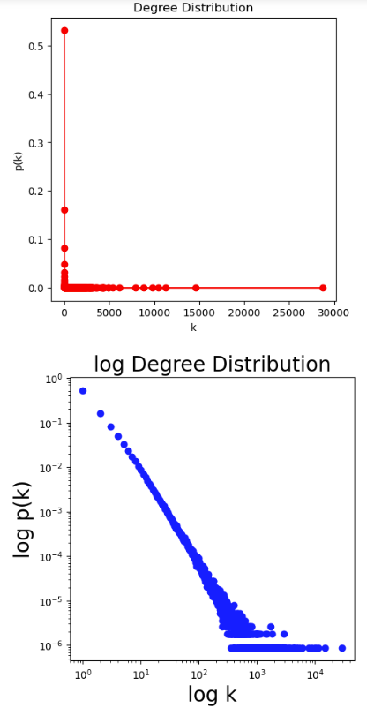
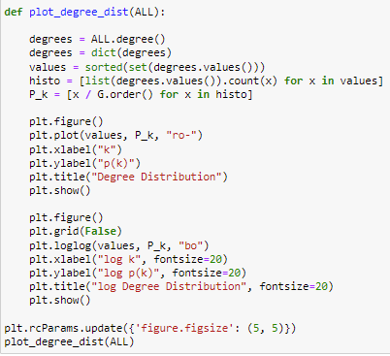
Degree Distribution

Slide 7
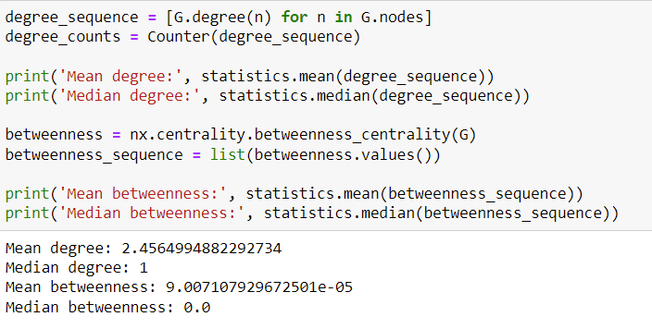
Centrality Distributions

Slide 8
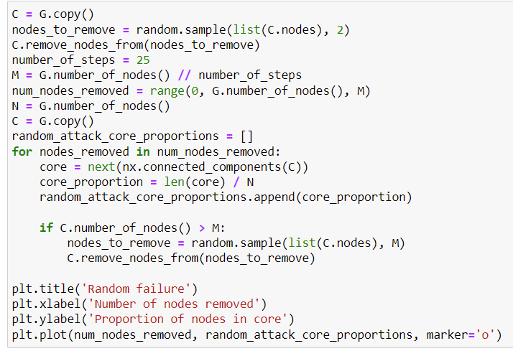
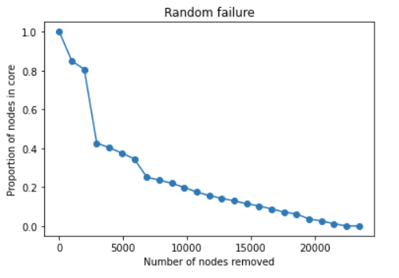
Random Failure

Slide 9
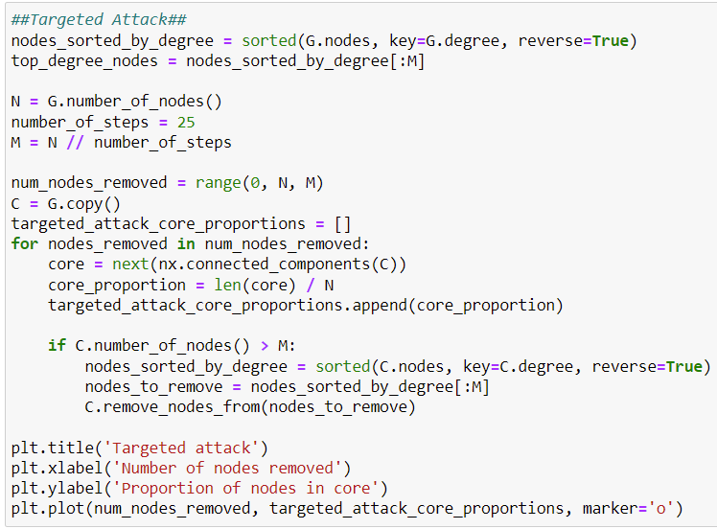
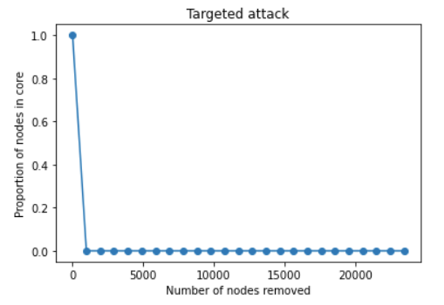
Targeted Attack

Slide 10
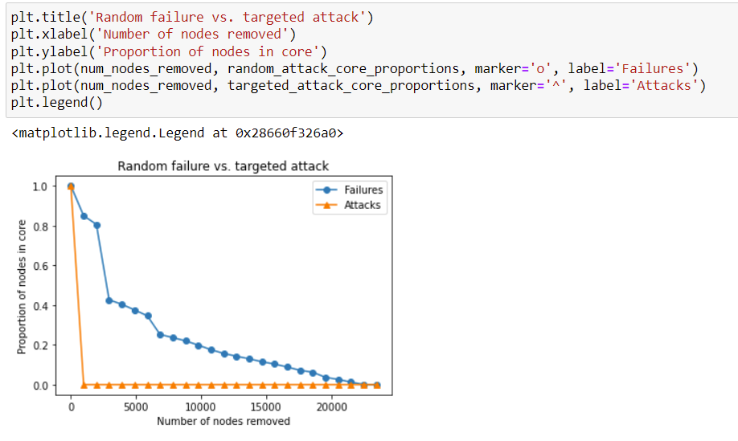
Random Failure vs. Targeted Attack

Slide 11
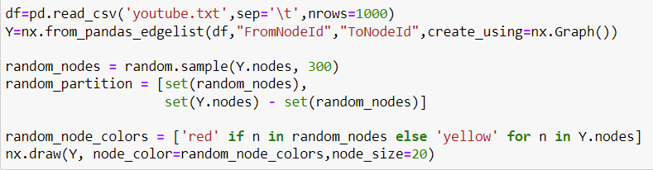
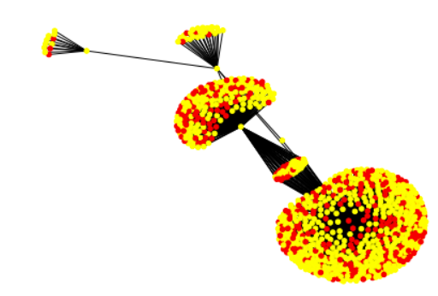

Modularity

Slide 12
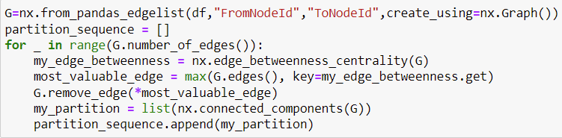

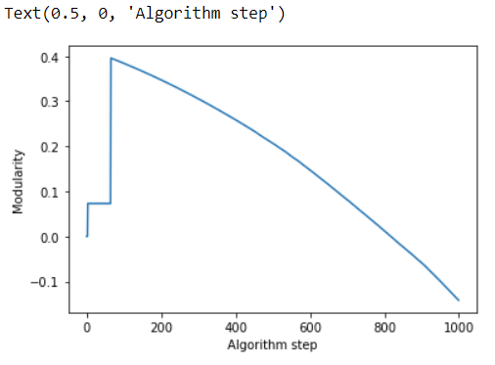
Girvan-Newman Clustering

Slide 13
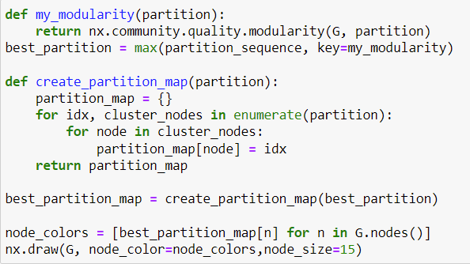
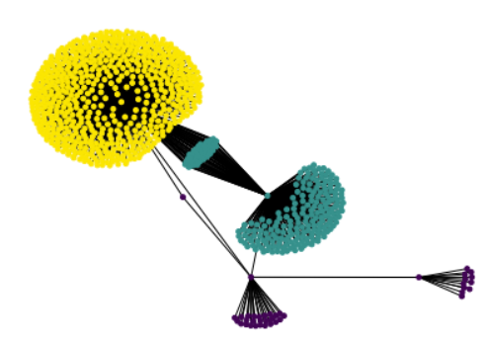

Partition with Highest Modularity

Slide 14
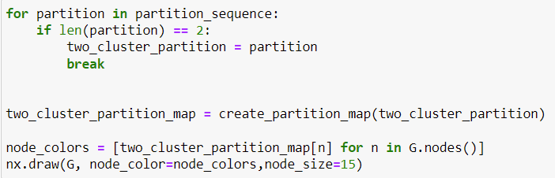
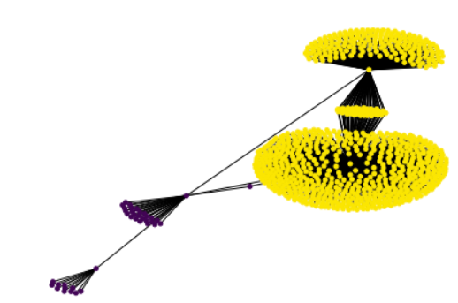

The Best Partition with a given number of communities

Slide 15
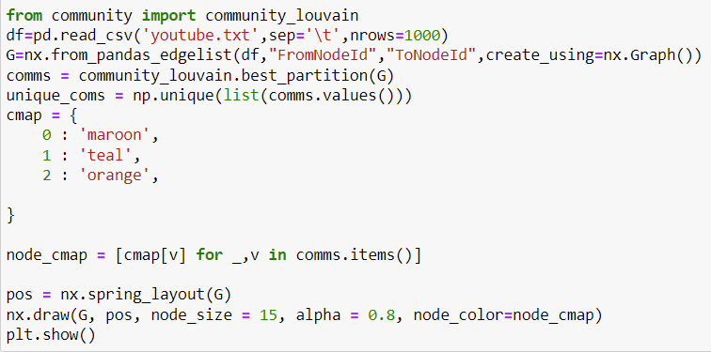
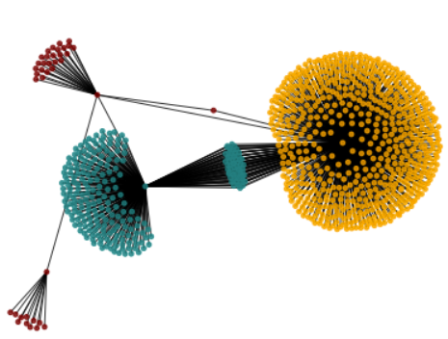
Louvain’s Algorithm for Community Detection

Slide 16
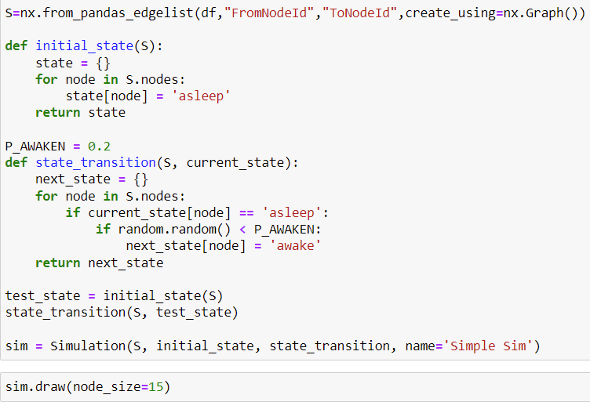
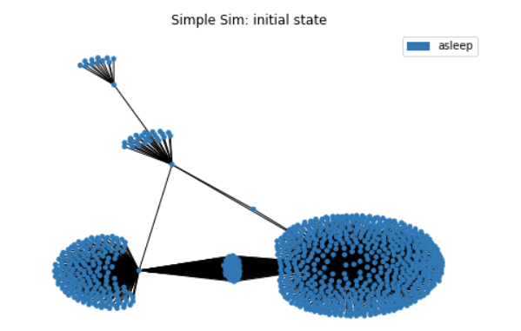
Simulation

Slide 17
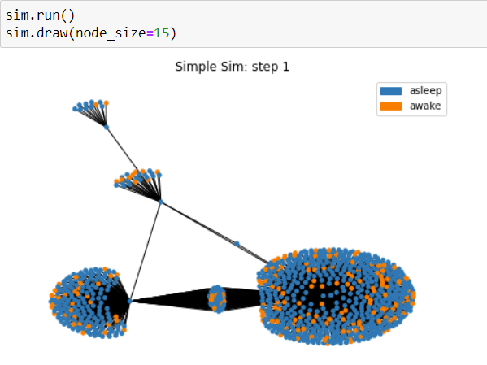
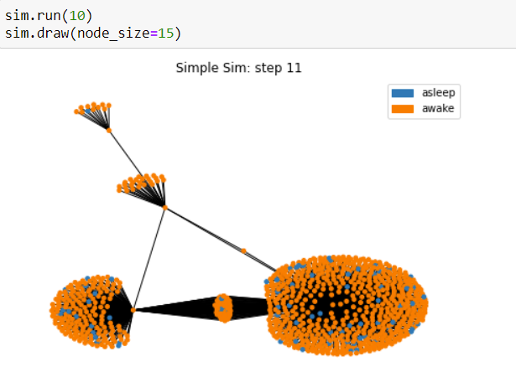
Simulation

Slide 18
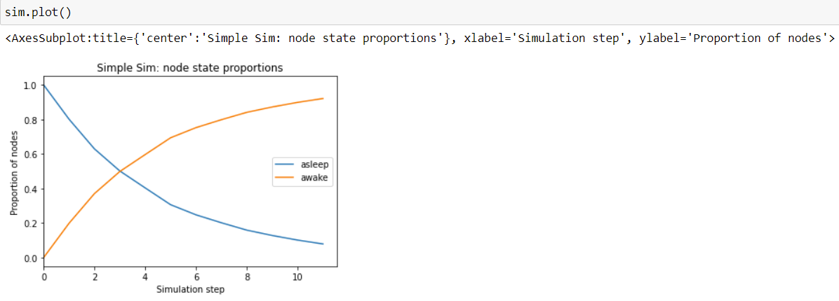
Simulation

